Slide 1
THE ADVANTAGES OF A STANDARDIZE DRIVER INTERFACE APPLICATION AKA THE DRIVER IN YOU
CRAC Staff Workshop
Imaging
3/15/2011

Slide 3
THE NEED FOR THE ULTIMATE DRIVING MACHINE
Prior to the 1990’s, customers interested in purchasing new scanners were restricted to only products of a certain series or manufacturer because not all interface devices allowed their existing peripheral equipment to effective communicate with other scanners.

Slide 4
SOLUTION - STANDARDIZE DRIVER INTERFACE
A standardize software protocol and application programming interface (API) for data exchange between a software application program and an image input device allows the customer more flexibility when selecting new scanners and peripheral equipment.

Slide 5
THREE MAIN COMPONENTS
Application Software
(Photo Retouching Software)
Software Manager
(Driver Interface)
Image Scanner Controls
(Scanner, camera)

Slide 6
COMPETITORS COME TOGETHER
In 1992, members of the imaging industry came together with the intention of standardizing communication between the image handling software and the hardware.

Slide 7
OBJECTIVES
Ensure image-handling software and hardware compatibility.
Keep the specification current with the state of current software and hardware while maintaining backward compatibility.
Provide multiple-platform support.
Maintain and distribute a no-charge developer's toolkit.
Ensure ease of implementation.
Encourage widespread adoption.
Open Source Data Source Manager

Slide 8
TYPICAL FUNCTIONS OF THE DRIVER INTERFACE

Slide 9
TWAIN DRIVER APPLICATION
Notes:
TwainDrive

Slide 10
IMAGE MODES

Slide 11
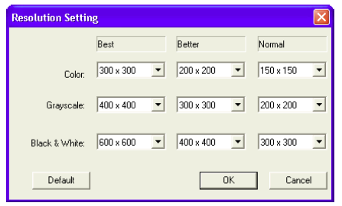
I. Resolutions/ Scan Types /Sizes

Slide 12
2. Image Modes
Color

Slide 13
How Most Scanners Work
When a document is scanned, the scanner is not scanning the words; they're scanning the lack of light the black ink that the word has relative to a white background page. The photo sensitive diodes convert the light (or lack of light) they catch into an electrical signal with the same information.

Slide 14
Capturing Images by Digitization Conversion of Light & Dark to a Bitmap Image
CHARGED COUPLED DIODES
A
0 | 1 | 1 | 1 | 0
0 | 1 | 1 | 1 | 0
0 | 1 | 1 | 1 | 0
1 | 1 | 0 | 1 | 1
A
Text
Binary Matrix
Bitmap Image
Light and Dark
1 = Dark & 0 = Light
Dots Per Inch (DPI)

Slide 15
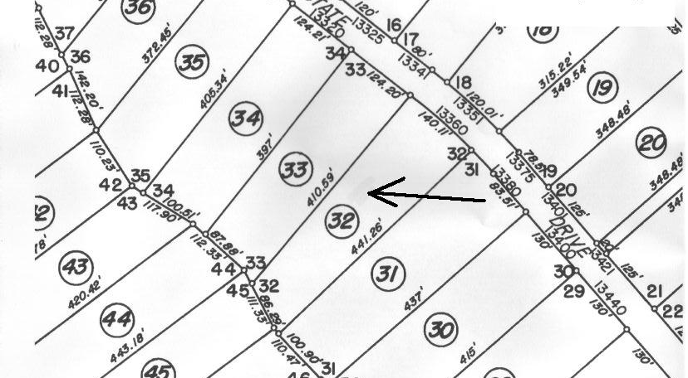
Black & White Mode
Black & White mode scans data by using the fixed threshold binary, black - white. This application distinguishes black and white by the setting of the “Threshold” variable.
Suitable for scanning line
drawings and text documents.

Slide 16
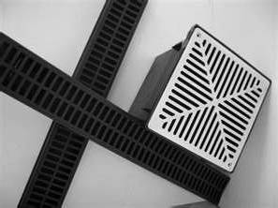
Halftone (Dithering) Mode
Halftone (*Dither)
Halftone scans data
by using the pattern
set in “Halftone” to
simulate data in
black -white.
Suitable for scanning images containing light and shadow such as a photograph.
Drainage System Addition
*Dithering is a technique used to create the illusion of depth in images with a limited .

Slide 17
Additional Halftone Presets
Pattern 0 - For scanning dark photographs.
Pattern 1 – For scanning dark colored documents
containing both text and photographs.
Pattern 2 – For scanning light photographs.
Pattern 3 – For scanning light colored photographs
containing both text and photographs.
Error Diffusion – Minimizes the difference between the
pixel density of the scanned image and the pixel density
of the printed image to create better reproduction of a
scanned photograph.
Download Pattern – Additional downloadable patterns.

Slide 18
Examples of Black & White Mode vs. Halftone Mode
Original Image |  | Black & white |  | Halftone

Slide 19
Gray Scale Mode
Gray Scale – Gray Scale scans
data using from 4 bit to 16 bit of
monochrome gray scale.
Light and shade in photographs
can be represented with
greater fidelity.
Warning: This mode may require more memory allocation than the Black & White mode.
Flood control Photo

Slide 20
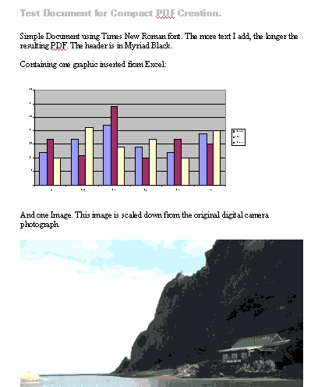
Automatic Separation Mode
Automatic Separation Mode scans data distinguishing line drawings from photograph images.
Suitable for documents
containing both photos
and line drawings or text.

Slide 21
Color Modes
Color Mode scans data using various levels of colors.
24 bit (16,777,216 levels of Color) - Suitable for scanning color photos. Will require more memory than Grayscale and Black & White Modes.
16 bit (65,536 levels of Color) - Data size is smaller and image quality inferior to 24bit Color.
8 bit (256 levels of Color - Data size is smaller and image quality inferior to 24bit Color & 16 bit.

Slide 22
24 bit Color 48 bit Color
1800 dpi 3,600 dpi

Slide 23
SEE (Selective Edge Emphasis Mode)
Selective Edge Emphasis Mode scans data using the halftone processing and emphasizes line drawings and text.
Suitable for emphasizing only text of documents containing both photo and text.

Slide 24
FINE SCAN ADJUSTMENTS

Slide 25
Three Main Adjustments
Brightness - Sets the overall brightness of the scanned image.
Threshold - Sets the difference between the black-to-white ratio in the scanned image.
Contrast - Sets the contrast between the light and the shadows in a scanned image.

Slide 26
Brightness Settings
Specifies the brightness with a number in the range of 1 (bright) to 255 (dark).
To darken overall image, increase the value of the settings. The brighten the overall image, decrease the value of the settings.

Slide 27
Threshold Setting
Sets the threshold value by which the black and white of black-and-white images are distinguished.
Specify a number in the range of 1 (bright) to 255 (dark)

Slide 28
Effect of Adjusting the Threshold Setting
A
A
A
Decrease Threshold
Normal
Increase Threshold

Slide 29
Static Threshold – scans using a simple binary processing based on the threshold setting.
SDTC mode - for scanning and fine binary processing of documents whose background are other than white, like newspapers.
DTC mode - scans in fine binary mode regardless of the document background.

Slide 30
Contrast Setting
Sets the control of light and shadow in a scanned image.
Specify the contrast with a number in the range of 1 (low [soft]) to 255 (high [sharp]).
If this value is increased, the dark part of the image is shown darker and the light part is shown lighter.

Slide 31
Effect of Adjusting the Contrast
A
A
A
Decrease Contrast
Normal
Increase Contrast

Slide 32
OTHER OPTIONS
Notes:
Option Settings

Slide 33
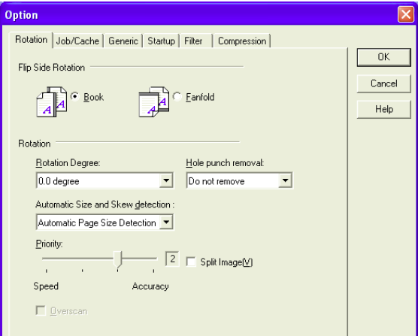
Rotation
Rotates the scanned image
0.0 degree
90.0 degree
-90.0 degree
180.0 degree
Automatic

Slide 34
Job/Cache
Allocates memory / Pre pick / Skip blank pages

Slide 35
Imprinter/Endorser
Imprint data on a prescanned document

Slide 36
Generic Unit Scaling
Sets up the units for the scanning perimeter and
the preview window.
Preview window

Slide 37
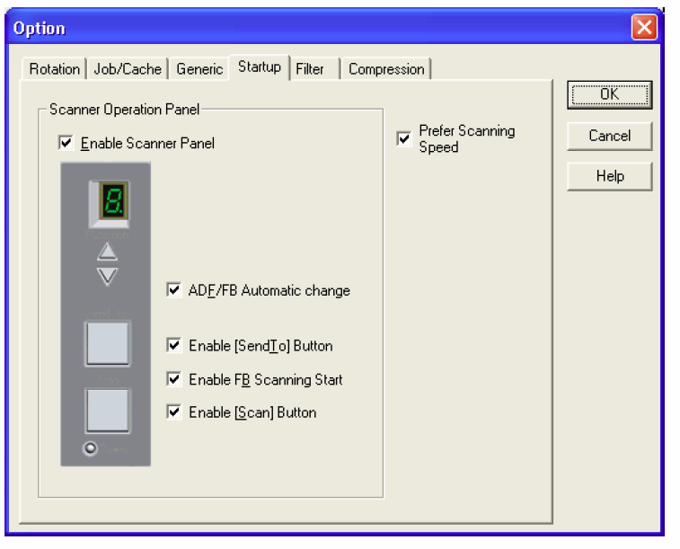
Startup
Enables the operational Panel to be active

Slide 38
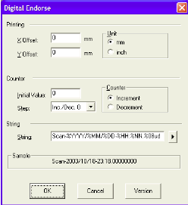
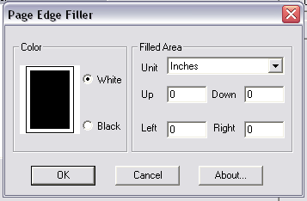
Filter
Imprints data on scanned image /Sets up the filtering process
Add data to scanned image.
Eliminate the blemishes around the edges.

Slide 39
Compression
Permit JPEG compression for data transfer from
image scanner

Slide 40
MANAGING THE FILE SETTINGS

Slide 41
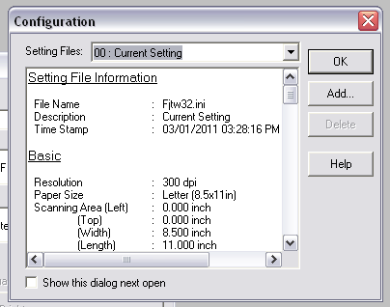
Adding and Saving File Setting

Slide 42
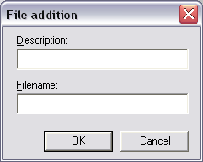
1. When the “File addition” window appears, enter in the description a “character string” the represents the file’s name and under “Filename” the specific name of the file. 2. Press “OK” to save or cancel to cancel the addition.

Slide 43
Accessing A Previously Saved File Setting

Slide 44
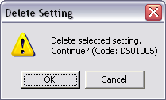
Deleting A Previously Saved File Setting

Slide 45
Conclusion
Due to the willingness by developers and vendors to work together to create a standardize software protocol and application programming interface (API) for data exchange, the end users now have the ability to refine the image quality to produce a excellent representation of the original document.

Slide 46
THE END

