Slide 1
A Guide to AB 918 & New Language Access Requirements in State Law
Jonathan Stein
Asian Americans Advancing Justice – Asian Law Caucus
Notes:
- Intro of myself.
- Pairs (1) voting rights work that will lower barriers to voting during this year’s critical 2016 elections with (2) civic engagement work that deepens Asian American communities’ investment in elections at the local level.

Slide 2
The Future Is Now
 | CA Latinos | CA Asian Americans
Population | 15.3 million | 5.9 million
% of total state population | 39% | 15%
Limited English proficiency (w/i pop.) | 34% | 36%
Speak a language other than English at home (w/i pop.) | 75% | 76%

Slide 3
Importance of Language Assistance in
Immigrant Communities
Use of language assistance in Los Angeles
  32% of Asian Americans
  Higher when broadened to include family
Varies significantly by ethnicity
  11% Filipino Americans
  46% Chinese Americans
  50% Korean Americans

Slide 4
What’s Changing?

Slide 5
What’s Changing?
New state law language determinations will be released by SOS by January 1, 2018.
Your coverage for existing languages may have grown or shifted geographically.
You may have coverage for new languages.
  Languages covered by state law requirements were artificially limited by the previous SOS.
  The artificial limitation on the languages has been eliminated as this SOS has moved to make the state complaint with state law.

Slide 6
What’s Changing?
Because of AB 918, what must be provided in all languages has been augmented.

Slide 7
What’s Not Changing?
Counties with federal Section 203 requirements still have those requirements. No change.
Will be updated after the next Census.

Slide 8
State Law
Language Access Req’s:
Before and After AB 918

Slide 9
State Law Language Access Requirements
Before AB 918

Slide 10
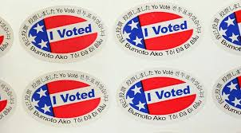
Facsimile Ballot Requirements
In precincts where a LEP language minority community exceeds a 3% threshold, a facsimile ballot in the community’s language needs to be conspicuously posted in the polling place.
Not changing.

Slide 11
Bilingual Poll Worker Requirements
Elections officials needs to make “reasonable efforts” to recruit bilingual poll workers speaking 3% languages.
At least 14 days before an election, the elections official needs to make available a list of the precincts to which bilingual poll workers are appointed.
Not changing.

Slide 12
State Law Language Access Requirements
After AB 918

Slide 13
Prior to Election Day – Facsimile Ballots
At least 14 days before an election, the county elections website must list all polling places online, including the languages of the facsimile ballots available at each, if any. (Sec. 14201(d).)
  Text surrounding/explaining the list must be in English and any 3% language.
The county voter information guide must refer LEP voters to this information on the county elections website. (Sec. 14201(e).)
  The text in the voter information guide must be in English and any 3% language.

Slide 14
Prior to Election Day – Vote-by-Mail
A vote-by-mail voter may request a facsimile ballot be sent to him/her if the voter lives in a covered precinct. (Sec. 13400(a).)
  The request maybe submitted by phone, mail, online, or when requesting a vote-by-mail ballot.
  Facsimile may be sent to voter via mail or email.
  Requested facsimile ballots must be prepared no later than 10 days before Election Day.
  Any request submitted within the week before Election Day can be rejected.

Slide 15
Prior to Election Day – Bilingual PW
Counties must still make “reasonable efforts” to recruit bilingual poll workers to staff polling places exceeding the 3% threshold. No change.
At least 14 days before an election, counties must still make available a list of the precincts to which bilingual poll workers are appointed. No change.
Poll workers must be trained on the purpose and proper handling of facsimile ballots. (Sec. 14201(c)(1).)

Slide 16
Prior to Election Day – Other
County elections website and voter information guide must inform LEP voters they can bring an assister to help them vote. (Sec. 14201(e).)
  Must be in all Section 203 languages and all 3% languages.

Slide 17
On Election Day – Facsimile Ballots
Number of facsimile ballots at polling places:
  One facsimile conspicuously posted. No change.
  One must be available for voters to take into the voting booth to be used as a reference, a/k/a in some loose leaf format. (Sec. 14201(b)(1).)
  Where the language minority group exceeds 20%, two more facsimiles must be available in loose leaf format. (Sec. 14201(b)(2).)

Slide 18
On Election Day – Facsimile Ballots
A sign must be posted near index of registration informing voters of presence of facsimile ballots. (Sec. 14201(c)(3).)
  Sign must be in English and any 3% languages relevant to that polling place.
  If a voter requests a facsimile that is available, poll worker must provide. (Sec. 14201(c)(2).)
Optional: Counties may replace facsimiles with translated, votable ballots. If they do so, they are freed of several requirements of Section 14201. (Sec. 14201(g)(2).)

Slide 19
On Election Day – Bilingual Poll Workers
Bilingual poll workers must wear something that identifies their language skills (e.g. name tag, button, etc.). (Sec. 12303(c)(3).)
Sign must be posted indicating the languages other than English that are spoken by the poll workers, if any. (Sec. 14200(g).)

Slide 20
After Election Day
Counties must send a report to SOS within 150 days of each statewide general election indicating the number of bilingual poll workers recruited that spoke each of the federal and state law languages in the county. (Section 12303(c)(2)(A).)

Slide 21
VCA Counties Only
AB 918 requirements for polling places also apply in Vote Centers. (Section 4005.6(a).)
For voters who have previously indicated a language preference, county must proactively send a facsimile in the preferred language if it is a facsimile the county is already required to prepare by Section 14201. (Sec. 4005.6(b).)
  Can be sent by mail or email.
  Must be received before Vote Centers open.
  No requirement to actively seek out new or updated language preference information.

Slide 22
What Help Can
We Provide?

Slide 23
Happy to provide PowerPoint and handout in electronic format.
Face-to-face meetings.
Always available for consultation by phone.
Toolkit with best practices from counties and implementation details?
What else can we provide?

Slide 24
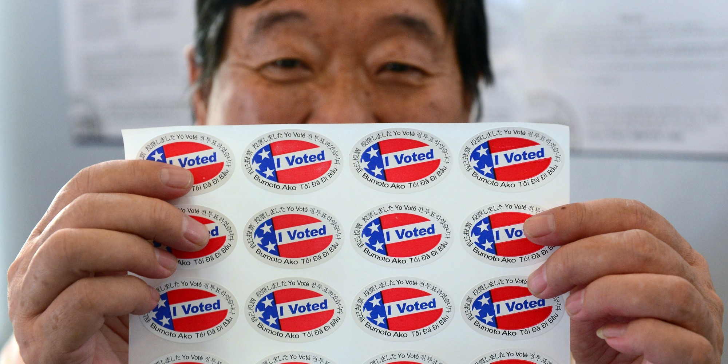
Questions?

Slide 25
Contact:
Jonathan Stein
Voting Rights Program Manager
Asian Americans Advancing Justice – Asian Law Caucus jonathans@advancingjustice-alc.org

