Slide 1
Online Registration Legislation
Chaptered August 7, 2009 and we went live March 1, 2010.
Less than 7 months to implement.
$200,000

Slide 2
How it Works
Must have Driver License or Driver Permit or State ID Number with a digital signature on file at DMV in order to register online.
Use signatures from DMV.
If they do not have a Driver License they can still use the system but will have to print out, sign, and return so we have their signature.

Slide 3
County Process
Batch uploaded to county every evening
More often in peak times
County staff review submission and accept registration
County sends postcard to voter

Slide 4
Efficiency Gains
Reduce the number of people re-registering with the same information
Get better quality data straight from the voter
No handwriting issues
Reduce the double-entry by elections staff
Spread the workload during high registration periods by minimizing the dumping of registration cards at the registration cut-off.

Slide 5
How many licks does it take to get to the Tootsie Roll center of a Tootsie Pop?

Slide 6
http://www.youtube.com/v/LZ0epRjfGLw

Slide 7
How many screens does it take to register to vote online in Oregon?

Slide 8
One

Slide 9
Two

Slide 10
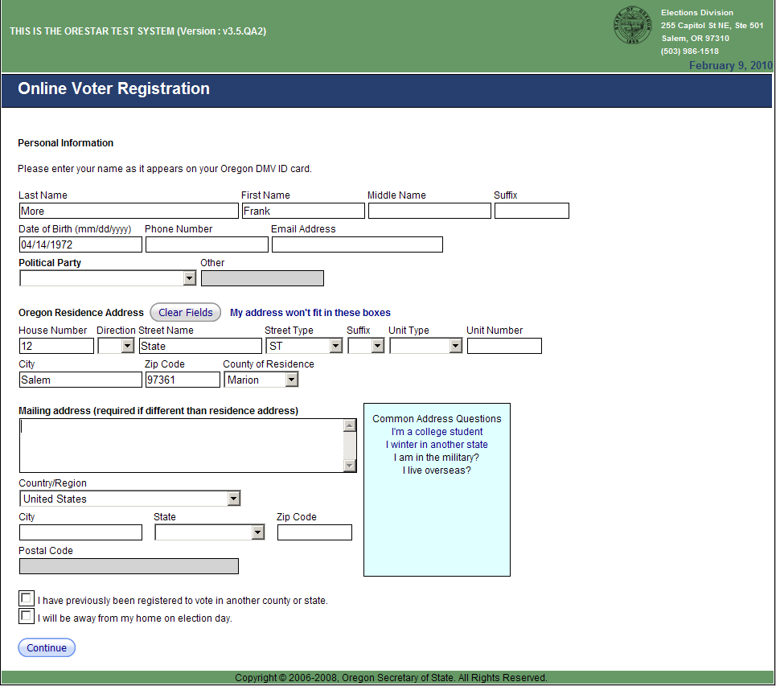
Three

Slide 11
Review and Submit

Slide 12
Other Exception Paths

Slide 13
Other Exception Paths

Slide 14
Online Registration by Age

Slide 15
Online Registration by Party

Slide 16
Online Registration by Date

Slide 17
Online Registrations vs. Paper Registrations

Slide 18
Surprises
Average age using the system the first week was older than me.
Some registration groups still use paper forms so they can track their registrants and build GOTV lists.

Slide 19
Online Voter Registration
Questions???
Steve Trout
State Election Director
Oregon Secretary of State
503-986-2339
Steve.trout@state.or.us

